Slide 1
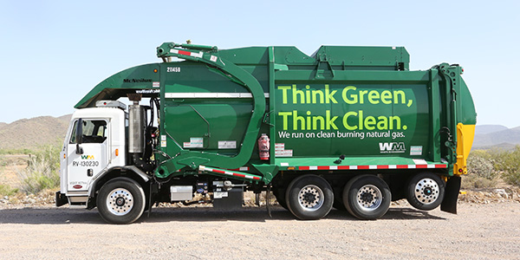
Project Stakeholders
Machine Learning and Vision for Front Load Trucks in Waste Management System
Project Executed By:
Prathap David Carlo
Data Analytics for Business
St. Clair College, Windsor
Project Instructor :
Prof. Muhammad Shahid
Data Analytics for Business
St. Clair College, Windsor
Project Sponsor :
Mr. Chris HO
General Project Manager
Metric Masters Ltd, BC

Slide 2
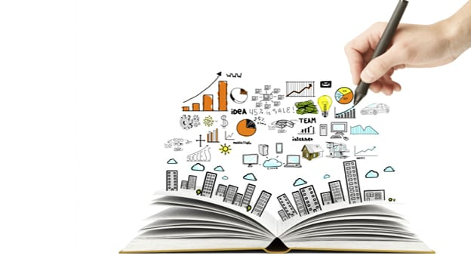
Agenda
Problem Statement
Factors Contributing to Problem Statement
Analytical Problem
Goals, Objectives and Metrics of the Project
Data Source
Tools and Technology
Exploratory Data Analytics
Machine Learning Models
Results
Future Recommendations
Conclusions
References
Notes:
Customer segmentation is a way of grouping or clustering clients based on shared demographic, psychographic and behavioural features such as age, gender, interests and spending habits. Occupation, gender, age, location, and marital status are all different examples of demographic traits. Social class, lifestyle, and personality traits are all psychographic features. Spending habits, consuming patterns, product/service usage, and previously acquired products are all behavioural traits.
The power of customer segmentation, could benefit in following ways:
1. Improved marketing campaigns: customer segmentation makes it possible to build tailored marketing messages to each particular segment. In fact, segmented campaigns have almost a 15% higher open rate than non-segmented ones.
2. Better offerings: knowing our customers allows to develop an offer for them so that it meets their particular needs to the best extent.
3. Greater return on sales: adjusting marketing efforts to company’s most successful customer segments can bring about an increase in revenue in the long run.
4. Increased loyalty and retention: personalization in every case matters. 80% of clients are more likely to do business with a brand that provides personalized experiences. So, customized content and individualized approach are what savours customer satisfaction and retention.
5. Untapped cross-selling and upselling opportunities: by segmenting existing and potential clients into groups, we realize what things they could be more interested in. It promotes the update of new products and services relevant to the targeted audience.
Conclusively, it is **important** because it aids in the identification of the most likely clients, makes it easier to manage and communicate with a specific audience. It boosts customer satisfaction, loyalty, and retention by improving customer relationships through better comprehending segment demands. Allows upselling and cross-selling opportunities by creating special offers for certain clients in order to persuade them to purchase more items. Customer segmentation aids in the identification of new customers by allowing for a better knowledge of the demands of various categories. **Each customer is valuable, and segmentation helps to create value for each one.**

Slide 3
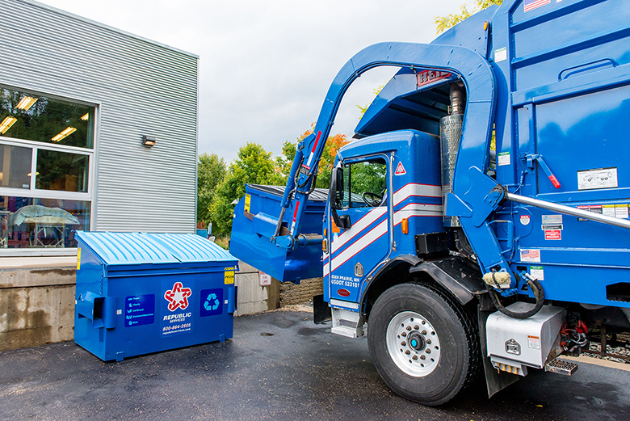
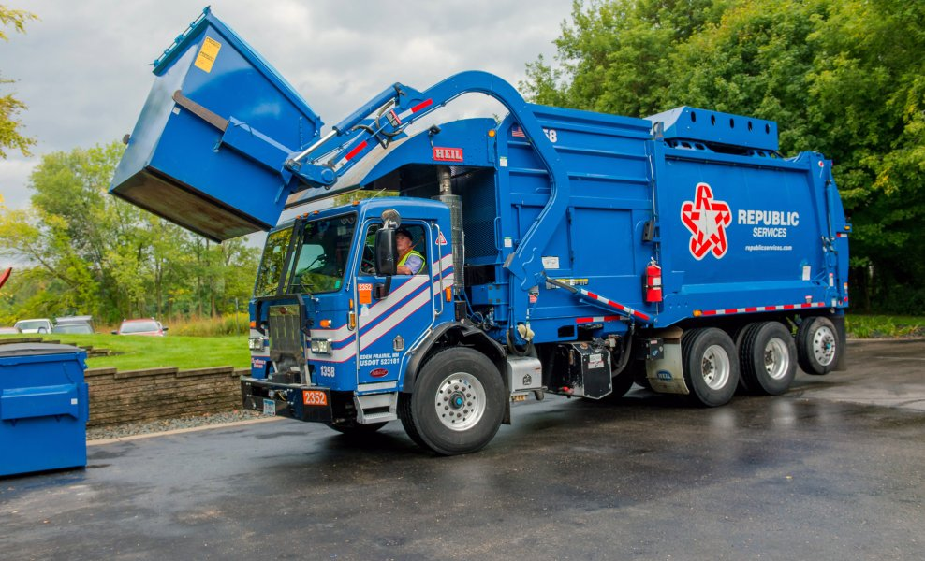
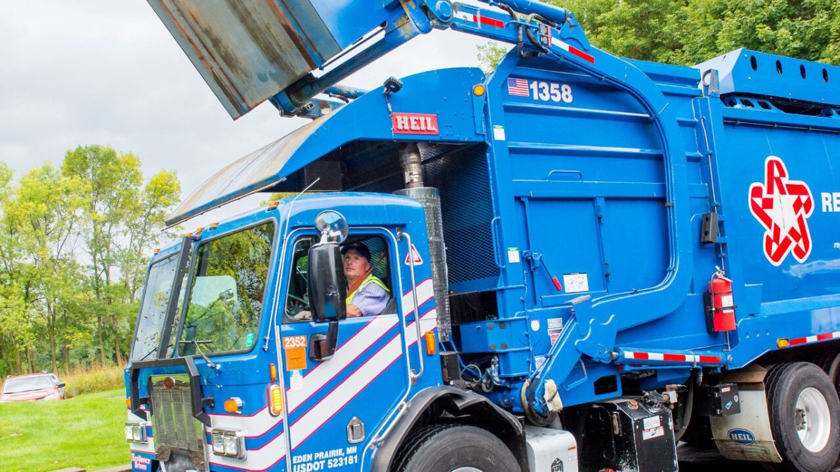
The need for having an efficient Waste Management Process is very essential to save our planet due to the enormous growth in human population and overconsumption of resources. Currently the garbage collection trucks are collecting the waste bins located across the cities with human assistance and manual interventions. However, it is impractical for the management to verify the accuracy of the executed data in terms of number of actual number of bins collected from the reports that is submitted by the truck operators to management upon completion of their daily work. Due to this, Waste management organizations are spending a lot of time and money in human resources, besides knowing the fact that it creates the room for malpractices through inaccurate data which in turn creates grievance/complaints from the customers claiming that there is no service is done to them.
Problem Statement

Slide 4
Contributing factors to Problem Statement
From customer perspective
A customer is charged 3 ways:
Rental of a bin.
A per lift/tip service.
Approximate weight disposed of at the landfill.
Why inaccurate data is produced by truck operators?
Moving the bin out of the way to get to a bin behind it
Relocating a bin to a different location on the same site
Lifting it to clear snow
Load is contaminated.
Driver spots material that’s not allowed in bin.
These aspects create room for malpractices that results in bad lift/No-lift/incomplete lift.
To avoid this, we need to have a lift detection technique to produce accurate results.
Notes:
Customer segmentation is a way of grouping or clustering clients based on shared demographic, psychographic and behavioural features such as age, gender, interests and spending habits. Occupation, gender, age, location, and marital status are all different examples of demographic traits. Social class, lifestyle, and personality traits are all psychographic features. Spending habits, consuming patterns, product/service usage, and previously acquired products are all behavioural traits.
The power of customer segmentation, could benefit in following ways:
1. Improved marketing campaigns: customer segmentation makes it possible to build tailored marketing messages to each particular segment. In fact, segmented campaigns have almost a 15% higher open rate than non-segmented ones.
2. Better offerings: knowing our customers allows to develop an offer for them so that it meets their particular needs to the best extent.
3. Greater return on sales: adjusting marketing efforts to company’s most successful customer segments can bring about an increase in revenue in the long run.
4. Increased loyalty and retention: personalization in every case matters. 80% of clients are more likely to do business with a brand that provides personalized experiences. So, customized content and individualized approach are what savours customer satisfaction and retention.
5. Untapped cross-selling and upselling opportunities: by segmenting existing and potential clients into groups, we realize what things they could be more interested in. It promotes the update of new products and services relevant to the targeted audience.
Conclusively, it is **important** because it aids in the identification of the most likely clients, makes it easier to manage and communicate with a specific audience. It boosts customer satisfaction, loyalty, and retention by improving customer relationships through better comprehending segment demands. Allows upselling and cross-selling opportunities by creating special offers for certain clients in order to persuade them to purchase more items. Customer segmentation aids in the identification of new customers by allowing for a better knowledge of the demands of various categories. **Each customer is valuable, and segmentation helps to create value for each one.**

Slide 5

Analytical Problem
Detection of Real-Time incidents recorded at every 3 seconds timestamp by cameras installed on front of the trucks using Deep Learning Architecture
Good Incidents: Complete Lift
Front Load Garbage Truck lifts the bin
Dump garbage
Return to its initial stage/any other place.
No Incidents : No Activity
If the vehicle is at the traffic
Obstacles in between
Not at the bin location
Bad incidents: Not Complete Lift
Front Load Garbage lifts the bin
Doesn’t dump garbage
Return to its initial state/ any other place.
Notes:
Customer segmentation is a way of grouping or clustering clients based on shared demographic, psychographic and behavioural features such as age, gender, interests and spending habits. Occupation, gender, age, location, and marital status are all different examples of demographic traits. Social class, lifestyle, and personality traits are all psychographic features. Spending habits, consuming patterns, product/service usage, and previously acquired products are all behavioural traits.
The power of customer segmentation, could benefit in following ways:
1. Improved marketing campaigns: customer segmentation makes it possible to build tailored marketing messages to each particular segment. In fact, segmented campaigns have almost a 15% higher open rate than non-segmented ones.
2. Better offerings: knowing our customers allows to develop an offer for them so that it meets their particular needs to the best extent.
3. Greater return on sales: adjusting marketing efforts to company’s most successful customer segments can bring about an increase in revenue in the long run.
4. Increased loyalty and retention: personalization in every case matters. 80% of clients are more likely to do business with a brand that provides personalized experiences. So, customized content and individualized approach are what savours customer satisfaction and retention.
5. Untapped cross-selling and upselling opportunities: by segmenting existing and potential clients into groups, we realize what things they could be more interested in. It promotes the update of new products and services relevant to the targeted audience.
Conclusively, it is **important** because it aids in the identification of the most likely clients, makes it easier to manage and communicate with a specific audience. It boosts customer satisfaction, loyalty, and retention by improving customer relationships through better comprehending segment demands. Allows upselling and cross-selling opportunities by creating special offers for certain clients in order to persuade them to purchase more items. Customer segmentation aids in the identification of new customers by allowing for a better knowledge of the demands of various categories. **Each customer is valuable, and segmentation helps to create value for each one.**

Slide 6
Related Work
Paper 1: Human Walking Activities Recognition [5]
This research work presents the multitask human walking activities recognition using human gait patterns. The data are collected for 50 subjects in a controlled laboratory environment using inertial measurement unit (IMU) sensors for 7 different activities. Four deep learning models are used. CNN–LSTM, CNN–GRU, LSTM–CNN and LSTM–GRU and their respective accuracies 97.26%, 90.67%, 77.38%, 97.83%, 94.35%, 97.64%, 96.98%.
Paper 2 : LSTM-CNN network for human activity recognition using Wi-Fi CSI data [6]
Wi-Fi based human activity recognition system that can identify different activities via the channel state information from Wi-Fi devices. A special deep learning framework, Long Short-Term Memory. Convolutional Neural Network (LSTM-CNN), is designed for accurate recognition. LSTMCNN is going to be compared with the LSTM network and the experimental results demonstrate that LSTM-CNN outperforms existing models and has an average accuracy of 94.14% in multiactivity classification
Paper 3 : Classification of Mental Stress Using CNN-LSTM Algorithms with Electrocardiogram Signals [7]
The mental stress faced by many people in modern society is a factor that causes various diseases. The person’s stress can be analyzed using Electrocardiogram (ECG) Signal and some parameters. Using Convolutional Neural Network (CNN) and Long Shot-Term Memory (LSTM) gained an accuracy of 98.3%. The performance evaluation is done by using Precision recall (PR), Confusion Matrices, and Receiver Operating Characteristics (ROC). Therefore, Model can help to manage and monitor the mental health of people exposed to stress. Which may have potential for development in various healthcare systems.
Paper 4 : Driver Fatigue Detection using LSTM [8]
In recent years, fatigue driving is the serious threat to traffic safety. Research on fatigue driving recognition has a great significance to improve traffic safety. To improve the accuracy and efficiency of detecting driver drowsiness multitask Convolutional Neural Network (MCNN) is used for detecting human face whereas, recognized facial images are passed as sequence to and Long Shot-Term Memory (LSTM) to gain feature value. As a result, this model gave 93% accuracy. They proposed a new, high-precision, real-time fatigue detection method based on the computer vision.
Notes:
Customer segmentation is a way of grouping or clustering clients based on shared demographic, psychographic and behavioural features such as age, gender, interests and spending habits. Occupation, gender, age, location, and marital status are all different examples of demographic traits. Social class, lifestyle, and personality traits are all psychographic features. Spending habits, consuming patterns, product/service usage, and previously acquired products are all behavioural traits.
The power of customer segmentation, could benefit in following ways:
1. Improved marketing campaigns: customer segmentation makes it possible to build tailored marketing messages to each particular segment. In fact, segmented campaigns have almost a 15% higher open rate than non-segmented ones.
2. Better offerings: knowing our customers allows to develop an offer for them so that it meets their particular needs to the best extent.
3. Greater return on sales: adjusting marketing efforts to company’s most successful customer segments can bring about an increase in revenue in the long run.
4. Increased loyalty and retention: personalization in every case matters. 80% of clients are more likely to do business with a brand that provides personalized experiences. So, customized content and individualized approach are what savours customer satisfaction and retention.
5. Untapped cross-selling and upselling opportunities: by segmenting existing and potential clients into groups, we realize what things they could be more interested in. It promotes the update of new products and services relevant to the targeted audience.
Conclusively, it is **important** because it aids in the identification of the most likely clients, makes it easier to manage and communicate with a specific audience. It boosts customer satisfaction, loyalty, and retention by improving customer relationships through better comprehending segment demands. Allows upselling and cross-selling opportunities by creating special offers for certain clients in order to persuade them to purchase more items. Customer segmentation aids in the identification of new customers by allowing for a better knowledge of the demands of various categories. **Each customer is valuable, and segmentation helps to create value for each one.**

Slide 7

Project Goals
To detect and report events of interest that are recorded by cameras installed on trucks during the process of garbage collection.
To design an optimized ML algorithm that brings out better accuracy to the classification problem for activities captured under low image resolutions.
Notes:
Customer segmentation is a way of grouping or clustering clients based on shared demographic, psychographic and behavioural features such as age, gender, interests and spending habits. Occupation, gender, age, location, and marital status are all different examples of demographic traits. Social class, lifestyle, and personality traits are all psychographic features. Spending habits, consuming patterns, product/service usage, and previously acquired products are all behavioural traits.
The power of customer segmentation, could benefit in following ways:
1. Improved marketing campaigns: customer segmentation makes it possible to build tailored marketing messages to each particular segment. In fact, segmented campaigns have almost a 15% higher open rate than non-segmented ones.
2. Better offerings: knowing our customers allows to develop an offer for them so that it meets their particular needs to the best extent.
3. Greater return on sales: adjusting marketing efforts to company’s most successful customer segments can bring about an increase in revenue in the long run.
4. Increased loyalty and retention: personalization in every case matters. 80% of clients are more likely to do business with a brand that provides personalized experiences. So, customized content and individualized approach are what savours customer satisfaction and retention.
5. Untapped cross-selling and upselling opportunities: by segmenting existing and potential clients into groups, we realize what things they could be more interested in. It promotes the update of new products and services relevant to the targeted audience.
Conclusively, it is **important** because it aids in the identification of the most likely clients, makes it easier to manage and communicate with a specific audience. It boosts customer satisfaction, loyalty, and retention by improving customer relationships through better comprehending segment demands. Allows upselling and cross-selling opportunities by creating special offers for certain clients in order to persuade them to purchase more items. Customer segmentation aids in the identification of new customers by allowing for a better knowledge of the demands of various categories. **Each customer is valuable, and segmentation helps to create value for each one.**

Slide 8
Objectives
To conduct background studies on various waste collection processes, waste management systems, applied AI concepts in real world for waste management process improvements.
To identify the potential ethical concerns related to the dataset
To explore required images to the solve the business problem considering number of images, their structure & sequence.
To build the machine learning algorithm that performs feature extraction, classification with training images in sequence and their testing.
To evaluate the performance of the machine learning algorithm.
To optimize the model with fine tuning.
To create final project report and the presentation.
Notes:
Customer segmentation is a way of grouping or clustering clients based on shared demographic, psychographic and behavioural features such as age, gender, interests and spending habits. Occupation, gender, age, location, and marital status are all different examples of demographic traits. Social class, lifestyle, and personality traits are all psychographic features. Spending habits, consuming patterns, product/service usage, and previously acquired products are all behavioural traits.
The power of customer segmentation, could benefit in following ways:
1. Improved marketing campaigns: customer segmentation makes it possible to build tailored marketing messages to each particular segment. In fact, segmented campaigns have almost a 15% higher open rate than non-segmented ones.
2. Better offerings: knowing our customers allows to develop an offer for them so that it meets their particular needs to the best extent.
3. Greater return on sales: adjusting marketing efforts to company’s most successful customer segments can bring about an increase in revenue in the long run.
4. Increased loyalty and retention: personalization in every case matters. 80% of clients are more likely to do business with a brand that provides personalized experiences. So, customized content and individualized approach are what savours customer satisfaction and retention.
5. Untapped cross-selling and upselling opportunities: by segmenting existing and potential clients into groups, we realize what things they could be more interested in. It promotes the update of new products and services relevant to the targeted audience.
Conclusively, it is **important** because it aids in the identification of the most likely clients, makes it easier to manage and communicate with a specific audience. It boosts customer satisfaction, loyalty, and retention by improving customer relationships through better comprehending segment demands. Allows upselling and cross-selling opportunities by creating special offers for certain clients in order to persuade them to purchase more items. Customer segmentation aids in the identification of new customers by allowing for a better knowledge of the demands of various categories. **Each customer is valuable, and segmentation helps to create value for each one.**

Slide 9
Metrics
• Literature review: Reviewing of 8 required Articles
• 5c’s : consent, clarity, consistency, control (and transparency), and consequences (and harm).
• Number of incidents, images, format, labels, image resolutions.
• Feature Extraction using Cov3D, Max-Pooling Layers , Padding, Dense and Dropout layers
• Model Performance Evaluation Metrics : Confusion matrix, Accuracy score, Recall score, Precision score, F1 score.
• Adaptive learning rate, optimization techniques(decay rate, learning rate, weight initiation, activation functions, batch size and number of epochs).
• Content(No. of pages), organized (References), Time spent and structured report.
Notes:
Customer segmentation is a way of grouping or clustering clients based on shared demographic, psychographic and behavioural features such as age, gender, interests and spending habits. Occupation, gender, age, location, and marital status are all different examples of demographic traits. Social class, lifestyle, and personality traits are all psychographic features. Spending habits, consuming patterns, product/service usage, and previously acquired products are all behavioural traits.
The power of customer segmentation, could benefit in following ways:
1. Improved marketing campaigns: customer segmentation makes it possible to build tailored marketing messages to each particular segment. In fact, segmented campaigns have almost a 15% higher open rate than non-segmented ones.
2. Better offerings: knowing our customers allows to develop an offer for them so that it meets their particular needs to the best extent.
3. Greater return on sales: adjusting marketing efforts to company’s most successful customer segments can bring about an increase in revenue in the long run.
4. Increased loyalty and retention: personalization in every case matters. 80% of clients are more likely to do business with a brand that provides personalized experiences. So, customized content and individualized approach are what savours customer satisfaction and retention.
5. Untapped cross-selling and upselling opportunities: by segmenting existing and potential clients into groups, we realize what things they could be more interested in. It promotes the update of new products and services relevant to the targeted audience.
Conclusively, it is **important** because it aids in the identification of the most likely clients, makes it easier to manage and communicate with a specific audience. It boosts customer satisfaction, loyalty, and retention by improving customer relationships through better comprehending segment demands. Allows upselling and cross-selling opportunities by creating special offers for certain clients in order to persuade them to purchase more items. Customer segmentation aids in the identification of new customers by allowing for a better knowledge of the demands of various categories. **Each customer is valuable, and segmentation helps to create value for each one.**

Slide 10

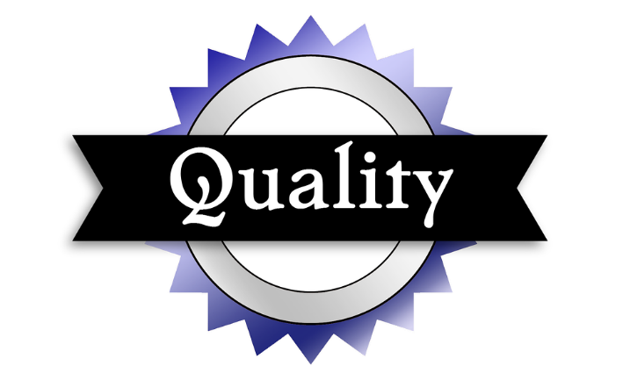
Data Source
The dataset has been provided by client and stored in a secure cloud storage.
1. Json File for speed of the vehicle being collected using the GPS system of the vehicle.
2. The Incident data consists of 20,000 images with 3 folders.
(Sequences of True lifts/Good Incidents , False Lifts/Bad Incidents and No Incidents )
3. Continuous Running Time dataset for 4 hours with approximately 6,000 images
Quality & Fitness
Images are found to be with uneven sequences. It makes sense as it is purely depending on the truck operators.
5 C’s
We have built a product that uses data ethically and responsibly following all the 5 C’s: consent, clarity, consistency, control (and transparency), and consequences (and harm)
Notes:
Customer segmentation is a way of grouping or clustering clients based on shared demographic, psychographic and behavioural features such as age, gender, interests and spending habits. Occupation, gender, age, location, and marital status are all different examples of demographic traits. Social class, lifestyle, and personality traits are all psychographic features. Spending habits, consuming patterns, product/service usage, and previously acquired products are all behavioural traits.
The power of customer segmentation, could benefit in following ways:
1. Improved marketing campaigns: customer segmentation makes it possible to build tailored marketing messages to each particular segment. In fact, segmented campaigns have almost a 15% higher open rate than non-segmented ones.
2. Better offerings: knowing our customers allows to develop an offer for them so that it meets their particular needs to the best extent.
3. Greater return on sales: adjusting marketing efforts to company’s most successful customer segments can bring about an increase in revenue in the long run.
4. Increased loyalty and retention: personalization in every case matters. 80% of clients are more likely to do business with a brand that provides personalized experiences. So, customized content and individualized approach are what savours customer satisfaction and retention.
5. Untapped cross-selling and upselling opportunities: by segmenting existing and potential clients into groups, we realize what things they could be more interested in. It promotes the update of new products and services relevant to the targeted audience.
Conclusively, it is **important** because it aids in the identification of the most likely clients, makes it easier to manage and communicate with a specific audience. It boosts customer satisfaction, loyalty, and retention by improving customer relationships through better comprehending segment demands. Allows upselling and cross-selling opportunities by creating special offers for certain clients in order to persuade them to purchase more items. Customer segmentation aids in the identification of new customers by allowing for a better knowledge of the demands of various categories. **Each customer is valuable, and segmentation helps to create value for each one.**

Slide 11


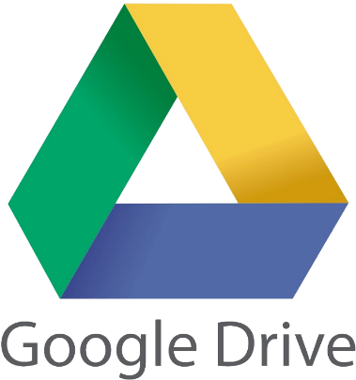




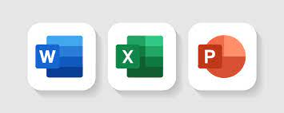
Tools and Technology
Programming Tool
Project Development Tools
Communication Tools
This Photo by Unknown Author is licensed under CC BY-NC
Notes:
Customer segmentation is a way of grouping or clustering clients based on shared demographic, psychographic and behavioural features such as age, gender, interests and spending habits. Occupation, gender, age, location, and marital status are all different examples of demographic traits. Social class, lifestyle, and personality traits are all psychographic features. Spending habits, consuming patterns, product/service usage, and previously acquired products are all behavioural traits.
The power of customer segmentation, could benefit in following ways:
1. Improved marketing campaigns: customer segmentation makes it possible to build tailored marketing messages to each particular segment. In fact, segmented campaigns have almost a 15% higher open rate than non-segmented ones.
2. Better offerings: knowing our customers allows to develop an offer for them so that it meets their particular needs to the best extent.
3. Greater return on sales: adjusting marketing efforts to company’s most successful customer segments can bring about an increase in revenue in the long run.
4. Increased loyalty and retention: personalization in every case matters. 80% of clients are more likely to do business with a brand that provides personalized experiences. So, customized content and individualized approach are what savours customer satisfaction and retention.
5. Untapped cross-selling and upselling opportunities: by segmenting existing and potential clients into groups, we realize what things they could be more interested in. It promotes the update of new products and services relevant to the targeted audience.
Conclusively, it is **important** because it aids in the identification of the most likely clients, makes it easier to manage and communicate with a specific audience. It boosts customer satisfaction, loyalty, and retention by improving customer relationships through better comprehending segment demands. Allows upselling and cross-selling opportunities by creating special offers for certain clients in order to persuade them to purchase more items. Customer segmentation aids in the identification of new customers by allowing for a better knowledge of the demands of various categories. **Each customer is valuable, and segmentation helps to create value for each one.**

Slide 12
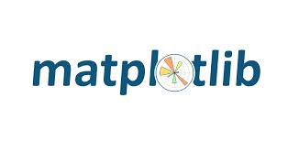
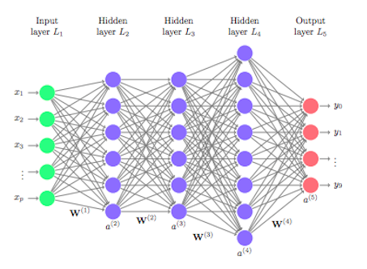


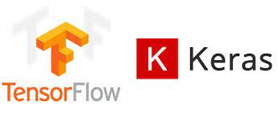

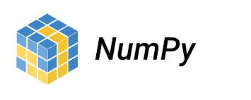
Tools and Technology
Technological skills adapted
Python Libraries
Deep leaning Architectures
CNN + LSTM
Notes:
Customer segmentation is a way of grouping or clustering clients based on shared demographic, psychographic and behavioural features such as age, gender, interests and spending habits. Occupation, gender, age, location, and marital status are all different examples of demographic traits. Social class, lifestyle, and personality traits are all psychographic features. Spending habits, consuming patterns, product/service usage, and previously acquired products are all behavioural traits.
The power of customer segmentation, could benefit in following ways:
1. Improved marketing campaigns: customer segmentation makes it possible to build tailored marketing messages to each particular segment. In fact, segmented campaigns have almost a 15% higher open rate than non-segmented ones.
2. Better offerings: knowing our customers allows to develop an offer for them so that it meets their particular needs to the best extent.
3. Greater return on sales: adjusting marketing efforts to company’s most successful customer segments can bring about an increase in revenue in the long run.
4. Increased loyalty and retention: personalization in every case matters. 80% of clients are more likely to do business with a brand that provides personalized experiences. So, customized content and individualized approach are what savours customer satisfaction and retention.
5. Untapped cross-selling and upselling opportunities: by segmenting existing and potential clients into groups, we realize what things they could be more interested in. It promotes the update of new products and services relevant to the targeted audience.
Conclusively, it is **important** because it aids in the identification of the most likely clients, makes it easier to manage and communicate with a specific audience. It boosts customer satisfaction, loyalty, and retention by improving customer relationships through better comprehending segment demands. Allows upselling and cross-selling opportunities by creating special offers for certain clients in order to persuade them to purchase more items. Customer segmentation aids in the identification of new customers by allowing for a better knowledge of the demands of various categories. **Each customer is valuable, and segmentation helps to create value for each one.**

Slide 13
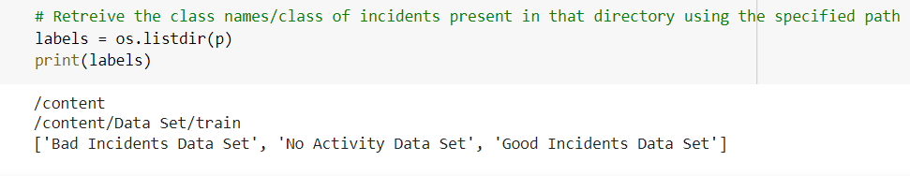
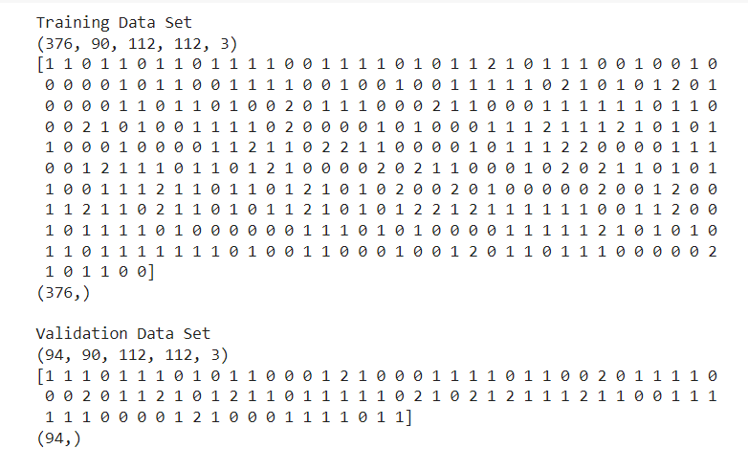
Exploratory Data Analysis
Incidents are labeled
Convert into Categorical
Good Incidents: True Positives -1
Bad incidents: True Negatives -0
No incidents: True Negatives -2
Good incidents : 174
Bad Incidents : 160
No Incidents : 136
Total : 470
Notes:
Customer segmentation is a way of grouping or clustering clients based on shared demographic, psychographic and behavioural features such as age, gender, interests and spending habits. Occupation, gender, age, location, and marital status are all different examples of demographic traits. Social class, lifestyle, and personality traits are all psychographic features. Spending habits, consuming patterns, product/service usage, and previously acquired products are all behavioural traits.
The power of customer segmentation, could benefit in following ways:
1. Improved marketing campaigns: customer segmentation makes it possible to build tailored marketing messages to each particular segment. In fact, segmented campaigns have almost a 15% higher open rate than non-segmented ones.
2. Better offerings: knowing our customers allows to develop an offer for them so that it meets their particular needs to the best extent.
3. Greater return on sales: adjusting marketing efforts to company’s most successful customer segments can bring about an increase in revenue in the long run.
4. Increased loyalty and retention: personalization in every case matters. 80% of clients are more likely to do business with a brand that provides personalized experiences. So, customized content and individualized approach are what savours customer satisfaction and retention.
5. Untapped cross-selling and upselling opportunities: by segmenting existing and potential clients into groups, we realize what things they could be more interested in. It promotes the update of new products and services relevant to the targeted audience.
Conclusively, it is **important** because it aids in the identification of the most likely clients, makes it easier to manage and communicate with a specific audience. It boosts customer satisfaction, loyalty, and retention by improving customer relationships through better comprehending segment demands. Allows upselling and cross-selling opportunities by creating special offers for certain clients in order to persuade them to purchase more items. Customer segmentation aids in the identification of new customers by allowing for a better knowledge of the demands of various categories. **Each customer is valuable, and segmentation helps to create value for each one.**

Slide 14
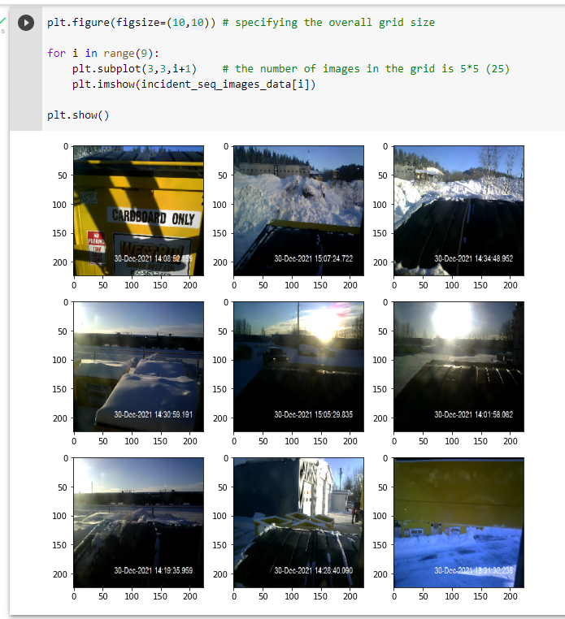
Exploratory Data Analysis
Image data representation is in a sequence as an incident
1.Convert image into 2D Array(matrix)
2. Convert sequences of images into list of array of incidents
3.Convert all incidents into 1 dimensional
Image Resize = 112*112
Number of incidents = 470
Sequence of images per incident = 90
Number channels = 3 (RGB)
Final input shape - (470,90,112*112,3)
Notes:
Customer segmentation is a way of grouping or clustering clients based on shared demographic, psychographic and behavioural features such as age, gender, interests and spending habits. Occupation, gender, age, location, and marital status are all different examples of demographic traits. Social class, lifestyle, and personality traits are all psychographic features. Spending habits, consuming patterns, product/service usage, and previously acquired products are all behavioural traits.
The power of customer segmentation, could benefit in following ways:
1. Improved marketing campaigns: customer segmentation makes it possible to build tailored marketing messages to each particular segment. In fact, segmented campaigns have almost a 15% higher open rate than non-segmented ones.
2. Better offerings: knowing our customers allows to develop an offer for them so that it meets their particular needs to the best extent.
3. Greater return on sales: adjusting marketing efforts to company’s most successful customer segments can bring about an increase in revenue in the long run.
4. Increased loyalty and retention: personalization in every case matters. 80% of clients are more likely to do business with a brand that provides personalized experiences. So, customized content and individualized approach are what savours customer satisfaction and retention.
5. Untapped cross-selling and upselling opportunities: by segmenting existing and potential clients into groups, we realize what things they could be more interested in. It promotes the update of new products and services relevant to the targeted audience.
Conclusively, it is **important** because it aids in the identification of the most likely clients, makes it easier to manage and communicate with a specific audience. It boosts customer satisfaction, loyalty, and retention by improving customer relationships through better comprehending segment demands. Allows upselling and cross-selling opportunities by creating special offers for certain clients in order to persuade them to purchase more items. Customer segmentation aids in the identification of new customers by allowing for a better knowledge of the demands of various categories. **Each customer is valuable, and segmentation helps to create value for each one.**

Slide 15
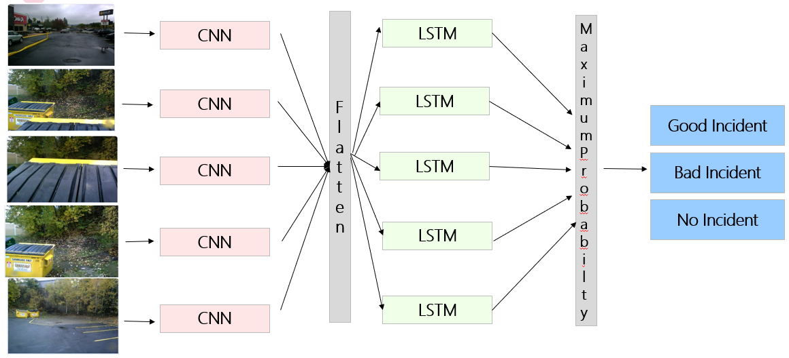
Deep Learning Architectures
LRCN is a combination of CNN and LSTM
The architecture enables to extract the Spatial information in the temporal structure using distributed layer- Spatiotemporal sequences
These spatiotemporal sequences are passed to the LTSM model as in input to generate three label classification
LRCN Model
(CNN with time distribution of sequence + LSTM)

Slide 16

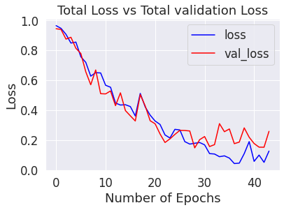
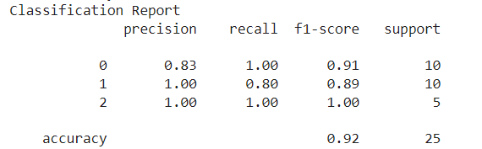
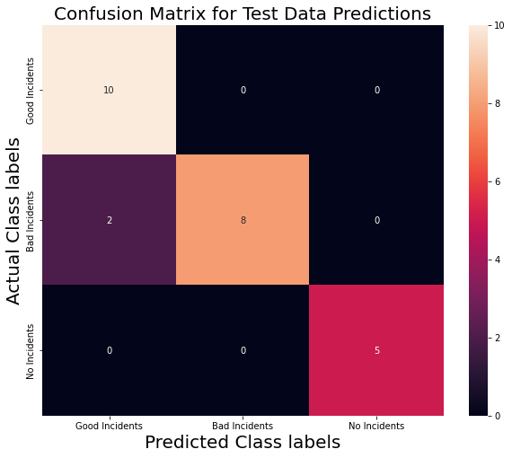
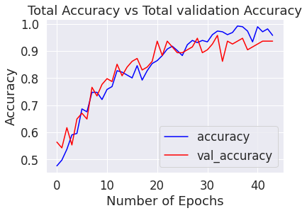
Results - LRCN Approach
Precision Score of 100% on Good incidents

Slide 17
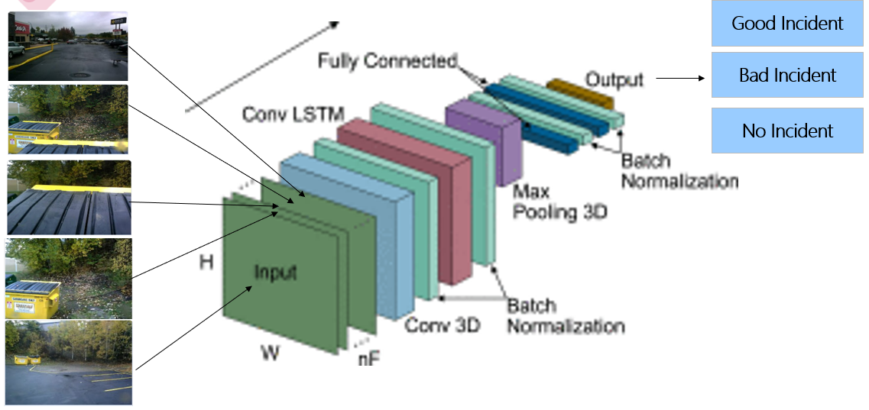
Deep learning Architectures
Applies a 3D convolution over an input signal composed of several input planes.
Softmax Activation Function for 3 label classification
Conv3D Model

Slide 18
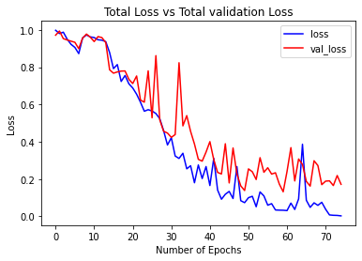

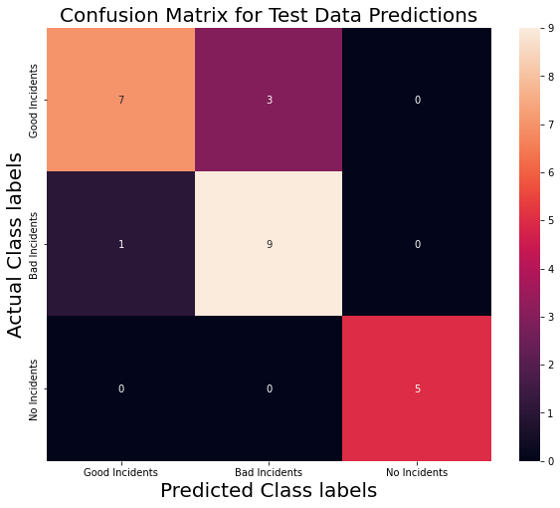
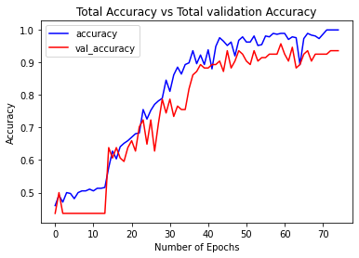
Results - CONV3D Model

Slide 19
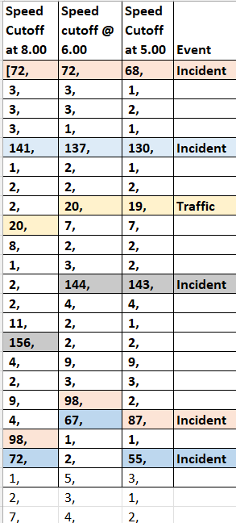
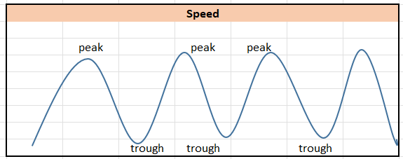
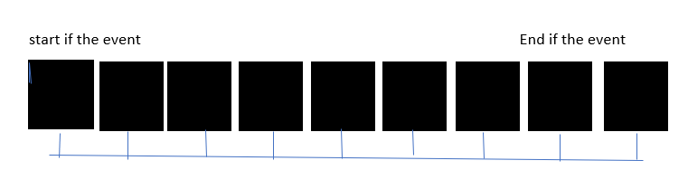
Real-Time Incident Prediction
Speed
Time
Time

Slide 20
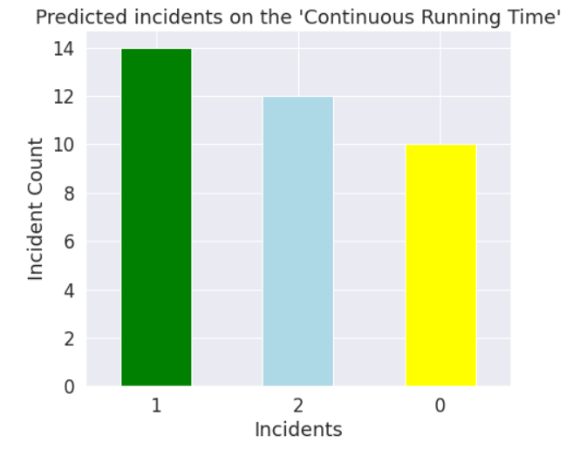
Real-Time Incidents
Realtime Good Incidents -14
Realtime Bad Incidents – 10
Realtime No incidents – 12
No Incidents and Bad Incidents can be ignored as they are taken into consideration as we are interested in Good Incidents only

Slide 21

Conclusion
Both the models are able to produce desirable results as expected.
Test Accuracy Comparison of both models tells that LRCN Architecture works the best for our data
Model can be Deployed for the Real-Time Scenario and then it needs continuous training
LRCN Model Test Accuracy : 92%
Conv3D Model Test Accuracy : 84%

Slide 22
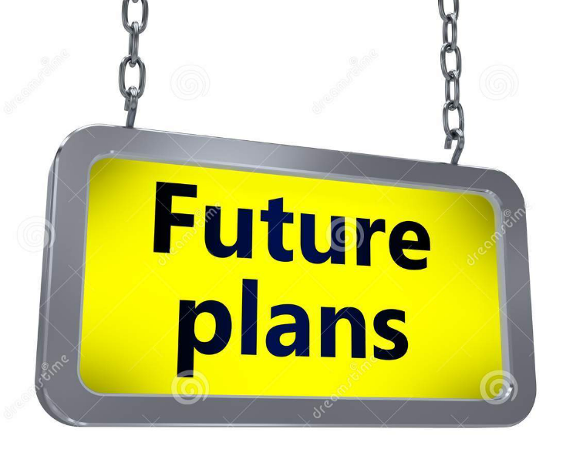
Building the model for all weather condition incidents which needs high level training with all condition sequence image data.
Fine Tuning it further to increase the test accuracy from 92%.
Use of bin detections tags/Geo locations ID to recognize the start and stop of the activity for better performances.
Deployment of the model to the real-time set up
Notes:
Customer segmentation is a way of grouping or clustering clients based on shared demographic, psychographic and behavioural features such as age, gender, interests and spending habits. Occupation, gender, age, location, and marital status are all different examples of demographic traits. Social class, lifestyle, and personality traits are all psychographic features. Spending habits, consuming patterns, product/service usage, and previously acquired products are all behavioural traits.
The power of customer segmentation, could benefit in following ways:
1. Improved marketing campaigns: customer segmentation makes it possible to build tailored marketing messages to each particular segment. In fact, segmented campaigns have almost a 15% higher open rate than non-segmented ones.
2. Better offerings: knowing our customers allows to develop an offer for them so that it meets their particular needs to the best extent.
3. Greater return on sales: adjusting marketing efforts to company’s most successful customer segments can bring about an increase in revenue in the long run.
4. Increased loyalty and retention: personalization in every case matters. 80% of clients are more likely to do business with a brand that provides personalized experiences. So, customized content and individualized approach are what savours customer satisfaction and retention.
5. Untapped cross-selling and upselling opportunities: by segmenting existing and potential clients into groups, we realize what things they could be more interested in. It promotes the update of new products and services relevant to the targeted audience.
Conclusively, it is **important** because it aids in the identification of the most likely clients, makes it easier to manage and communicate with a specific audience. It boosts customer satisfaction, loyalty, and retention by improving customer relationships through better comprehending segment demands. Allows upselling and cross-selling opportunities by creating special offers for certain clients in order to persuade them to purchase more items. Customer segmentation aids in the identification of new customers by allowing for a better knowledge of the demands of various categories. **Each customer is valuable, and segmentation helps to create value for each one.**

Slide 23
References
[1] A. -M. R. Abdali and R. F. Al-Tuma, "Robust Real-Time Violence Detection in Video Using CNN And LSTM," 2019 2nd Scientific Conference of Computer Sciences (SCCS), 2019, pp. 104-108, doi: 10.1109/SCCS.2019.8852616.
[2] Shi, X., Chen, Z., Wang, H., Yeung, D. Y., Wong, W. K., & Woo, W. C. (2015). Convolutional LSTM network: A machine learning approach for precipitation nowcasting. Advances in neural information processing systems, 28.
[3] Xia, K., Huang, J., & Wang, H. (2020). LSTM-CNN architecture for human activity recognition. IEEE Access: Practical Innovations, Open Solutions, 8, 56855–56866. https://doi.org/10.1109/access.2020.2982225
[4] Anh Khoa, T., Phuc, C. H., Lam, P. D., Nhu, L. M. B., Trong, N. M., Phuong, N. T. H., Van Dung, N., Tan-Y, N., Nguyen, H. N., & Duc, D. N. M. (2020). Waste management system using IoT-based machine learning in university. Wireless Communications and Mobile Computing, 2020, 1–13. https://doi.org/10.1155/2020/6138637
[5] Semwal, V. B., Gupta, A., & Lalwani, P. (2021). An optimized hybrid deep learning model using ensemble learning approach for human walking activities recognition. The Journal of Supercomputing, 77(11), 12256-12279.
[6] Shang, S., Luo, Q., Zhao, J., Xue, R., Sun, W., & Bao, N. (2021, April). LSTM-CNN network for human activity recognition using WiFi CSI data. In Journal of Physics: Conference Series (Vol. 1883, No. 1, p. 012139). IOP Publishing.

Slide 24
References
[7] Mingu Kang, Siho Shin, Jaehyo Jung, Youn Tae Kim, "Classification of Mental Stress Using CNN-LSTM Algorithms with Electrocardiogram Signals", Journal of Healthcare Engineering, vol. 2021, Article ID 9951905, 11 pages, 2021.
[8] Long Chen, Guojiang Xin, Yuling Liu, Junwei Huang, "Driver Fatigue Detection Based on Facial Key Points and LSTM", Security and Communication Networks, vol. 2021, Article ID 5383573, 9 pages, 2021.
[9] Brownlee, J. (2019, August 14). CNN Long Short-Term Memory Networks. Machine Learning Mastery. https://machinelearningmastery.com/cnn-long-short-term-memory-networks/
[10] Golubev, A. (2021, December 22). Long-term Recurrent Convolutional Network for Video Regression. Medium. https://towardsdatascience.com/long-term-recurrent-convolutional-network-for-video-regression-12138f8b4713
Golubev, A. (2021, December 22). Long-term Recurrent Convolutional Network for Video Regression. Medium. https://towardsdatascience.com/long-term-recurrent-convolutional-network-for-video-regression-12138f8b4713
[11] Chan, M. (2021, December 14). Pytorch: Step by Step implementation 3D Convolution Neural Network. Medium. https://towardsdatascience.com/pytorch-step-by-step-implementation-3d-convolution-neural-network-8bf38c70e8b3

Slide 25
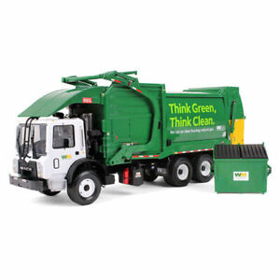

Slide 10

